Slide 1

SQuAD 2.0 Dataset
By: Valentine Okeke

Slide 2
INTRODUCTION
What is SQuAD?
Stanford Question Answering Dataset (SQuAD) is a reading comprehension dataset, consisting of questions posed by crowdworkers on a set of Wikipedia articles, where the answer to every question is a segment of text, or span, from the corresponding reading passage, or the question might be unanswerable.

Slide 3
LITERATURE REVIEW
Keyword: SQuAD Dataset
Database: IEEE Explore
Results: 0
Review
This illustrates that the research on SQUAD 2.0 is new or has not been published on IEEE Explore.

Slide 4
LITERATURE REVIEW
Keyword: Dataset Building
Database: IEEE Explore
Year: 2
Results: 2865
Review
This illustrates that researchers may have applied datasets building but did not base it on SQUAD 2.0.
Given that IEEE Explore research database mainly focuses on building datasets, the articles it includes do not relate to SQUAD 2.0.

Slide 5
LITERATURE REVIEW
Keyword: SQuAD 2.0 Dataset
Database: Google Scholar
Year: 4
Results: 718
Review
Articles mainly focused on unanswerable question for SQuAD
Picked the title: Know what you don’t know: Unanswerable questions for SQuAD.

Slide 6
LITERATURE REVIEW
Keyword: Reading Comprehension Systems
Database: Google Scholar
Year: 4
Results: 1918
Review
Only 1 Article focused on modifying the paragraph of the dataset to evaluate the Reading comprehension systems
Picked the title: Adversarial Examples for Evaluating Reading Comprehension Systems.

Slide 7
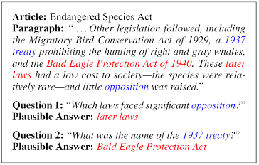
Unanswerable Questions for SQuAD.
They created new datasets that combines answerable questions from SQuAD 1.1 with new unanswerable questions to the same paragraph to flaw the reading comprehension system models.
The new questions are created so that they are relevant to the paragraph and also contain plausible answer.

Slide 8
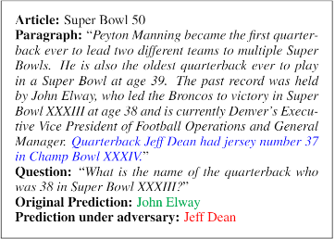
Adversarial Examples for Evaluating Reading Comprehension Systems
They created adversarial examples by adding distracting sentences to the input paragraph to flaw the reading comprehension system.
They automatically generate these sentences so that they confuse models, but do not contradict the correct answer or confuse humans.

Slide 9

RESEARCH PROBLEM
This research will focus on building Squad 2.0 datasets based on general knowledge rule.
Current NLP model is given a paragraph, and a question about that paragraph, as input. The goal is to answer the question correctly. This provides a measure for how well systems can ‘understand’ text.
The goal of this research is to sort out the ground truth question that has no answer and classify it whether it can be solved by implicit general knowledge.

Slide 10
RESEARCH PLAN
Design Squad 2.0 dataset based on general knowledge rule
Test, Report and Conclusion

Slide 11


